Slide 1
A leading automotive technology company

Slide 2
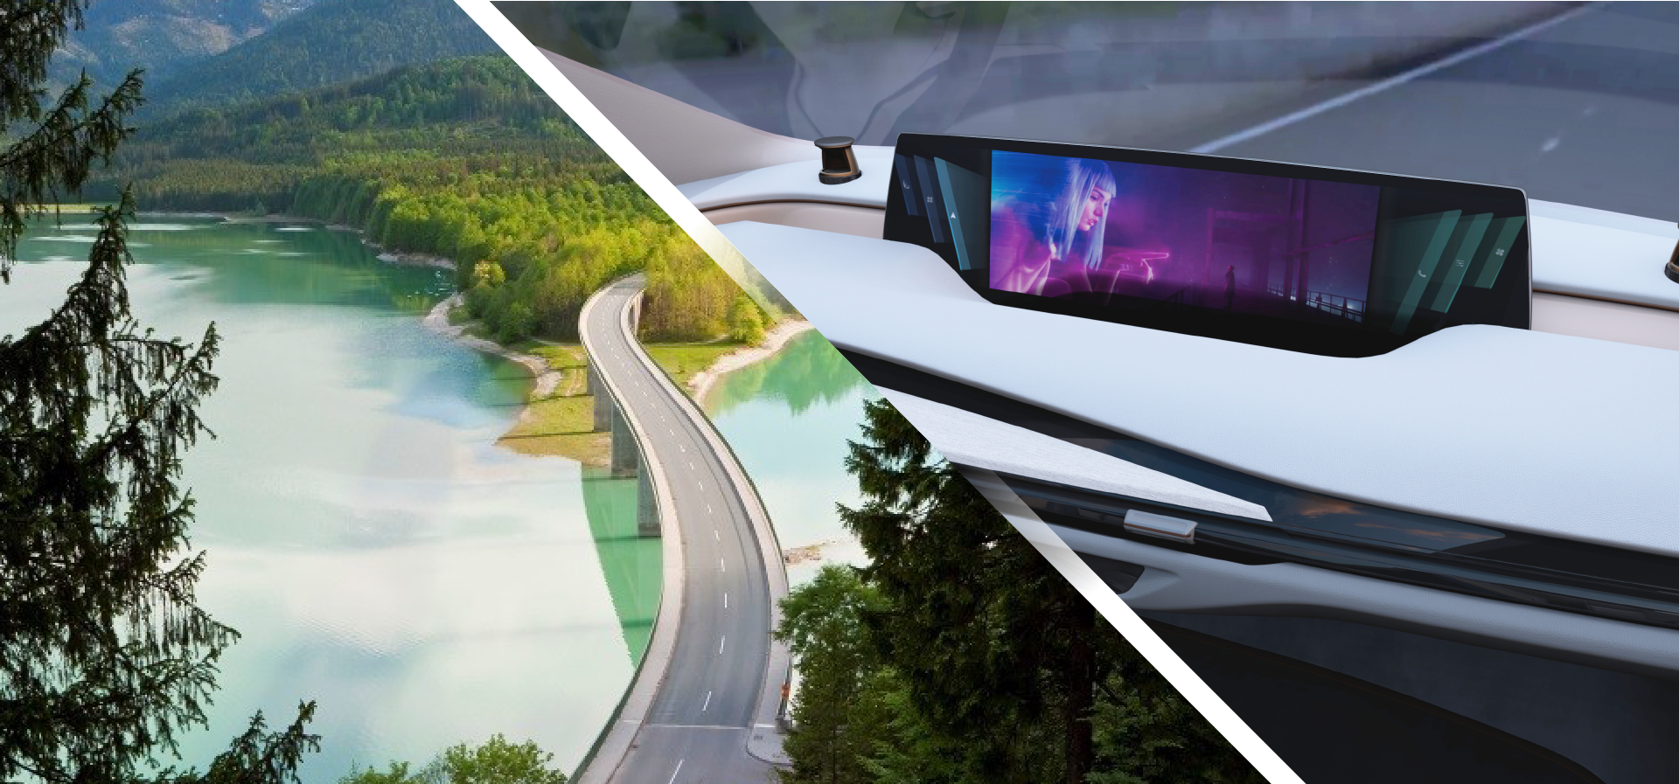
A technology company with two strategic priorities
Sustainable Mobility
Solutions for fuel efficiency and air quality
Smart Life on Board
Solutions for a connected, versatile and predictive cockpit

Slide 3
A strategic and global partner
Top ten automotive company,€17 billion of sales
A trusted partner for global automakers, Chinese OEMs, pure EV players, commercial vehicles, fleet sand cities
A leading player in Clean Mobility, Interiors and Seating
A customer centric company
with 300 sites in 35 countries
1 vehicle in 3 in the world includes
a Faurecia technology

Slide 4
Strong innovation to accelerate the technology revolution
6400 Engineers
In 30 R&D centers
25 academic research establishments in open innovation network
370 experts in
54 strategic areas
5 Technology plaforms in all regions
€ 160 M investment in innovation
+23% vs 2016
€ 50 M to invest
in startups with Faurecia Ventures
370 patents
First filing in 2017
+35% vs 2016
4

Slide 5
A diverse, agile and learning company
109 000
employees of
90 nationalities
30%
of our workforce
is female
10 000
recruitments
per year
1.7 million
hours of training
per year
2 800
Internships, apprenticeships
or VIE*
27 500
employees connected to our MOOC platform and to our internal social network
*VIE : Volunteer for International Experience
5

Slide 6
Faurecia ambition
Provide intelligent and disruptive solutions for a Smart Life on Board and Sustainable Mobility experience
Accelerate our technology leadership and provide excellence in execution
Provide an inspiring environment
6

